Slide 1
EDA Project Automobile Data Set
Abhimnew Kumar
Batch: Aug-19
24-11-2019

Slide 2
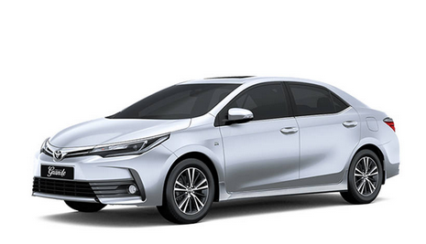
Problem Statement : by Analyzing Automobile (CAR) data Set
Studying car sales in market according to different criteria which are critical for buyer. List of criteria mention below.
Body Style
Fuel-type
No. of cylinders
Aspiration
No. of Doors
Make

Slide 3

Analysis by raising Questions at different stages
Which car make having high number of sales ?
What is the percentage contribution of car sales from different body style?
Which car engine having high demand among customer ?
What is the distribution of car sales as per number of cylinders?
Which fuel type car is most preferred by customer ?

Slide 4
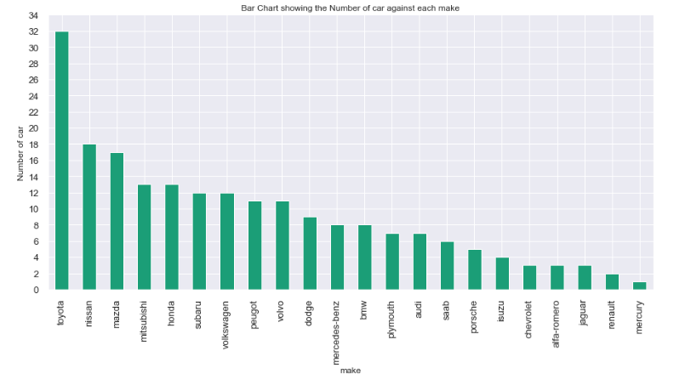
CAR Sales Analysis: Make wise
Toyota, Nissan & Mazda top 3 contributor in car sales.

Slide 5
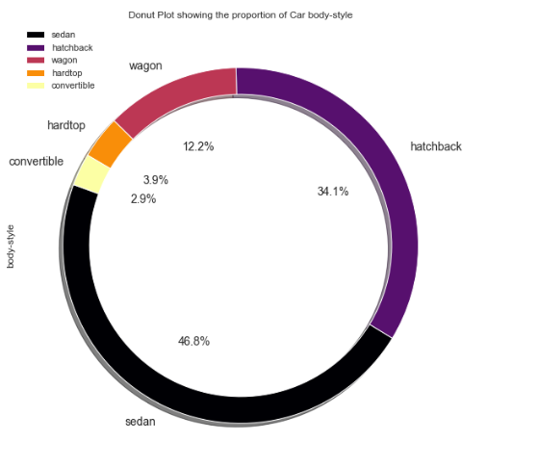
CAR Sales Analysis: Body type wise
Sedan & hatchback model top 2 contributor in car sales.

Slide 6
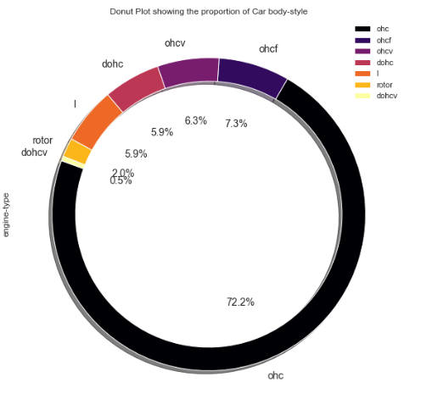
CAR Sales Analysis: Engine wise
Ohc engine model top contributor in car sales.

Slide 7
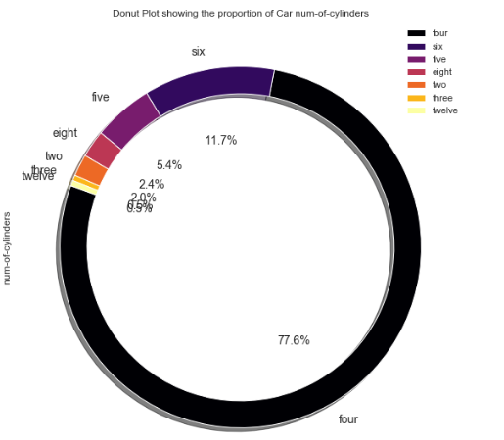
CAR Sales Analysis: No. of cylinder wise
Four cylinder car top contributor in car sales.

Slide 8
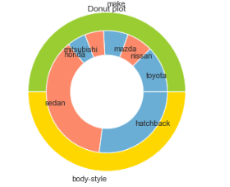
CAR Sales Analysis: Combine (make & Body type)
Toyota/Nissan/mazda/Mitsubishi & honda having majority contribution among Sedan & hatchback Car

Slide 9
Thank You

